Slide 1

Welcome
To
My Presentation

Slide 2

Integrated Marketing Communication (IMC) Champaign of “PITHA ANGON.”
Presented
by
Md. Roich Hasan

Slide 3

Introduction
Importance of Integrated Marketing Communication (IMC):
Consistency in Brand Messaging
Enhanced Brand Image and Credibility
Improved Efficiency and Cost-Effectiveness
Greater Accountability and Measurement
Enhanced Customer Relationships
Competitive Advantage
Integrated Marketing Communication (IMC) is a strategic approach that blends and coordinates various communication channels and marketing tools to deliver a consistent, clear, and compelling message about a brand or organization.

Slide 4

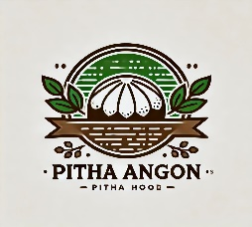
Company Overview:
“Pitha Angon” is a specialty food company that focuses on producing traditional Bangladeshi sweets, particularly pithas. The company was established with the goal of keeping the rich cultural heritage of Bangladesh alive through its unique, handmade products. It prides itself on using high-quality, natural ingredients and traditional methods to create pithas that not only taste authentic but also carry the cultural essence of Bangladesh.

Slide 5

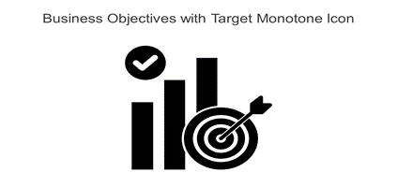
Objectives of the IMC Champaigns of “Pitha Angon”
key objectives
key objectives
Brand Awareness
Customer Engagement
Consistent Messaging
Promotion of Products and Services
Customer Loyalty
Sales Increase
1 Target Market Reach
2 Feedback and Improvement
3 Digital Presence Enhancement

Slide 6

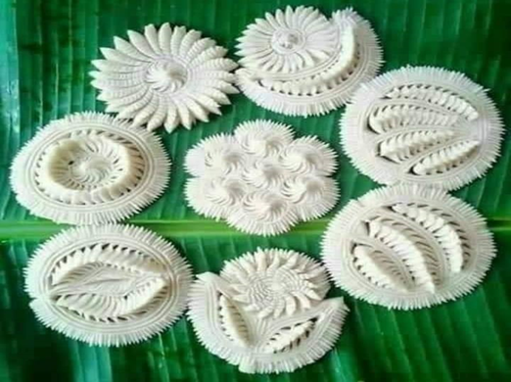
Situation Analysis
Market Overview: Nakhsi Pitha, traditionally known in rural settings, is gaining popularity among urban consumers due to its cultural value, unique taste, and health benefits (as it is often made from natural ingredients). The trend toward traditional foods presents a significant opportunity for expansion. The market for ethnic and traditional foods is growing, with consumers showing increased interest in artisanal, homemade, and region-specific delicacies.

Slide 7



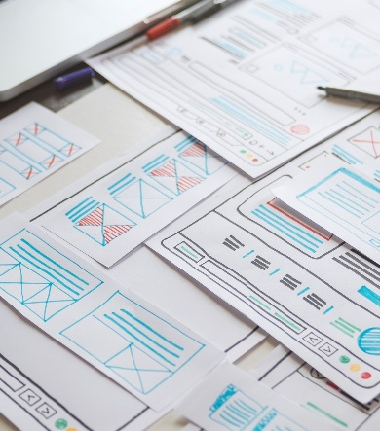


Target Audience for Nakhsi Pitha includes:
Urban Middle-Class Consumers
Food Enthusiasts
Diaspora Communities
Demographics
Geographic's
Particularly those interested in traditional foods, nostalgia, and healthier food options.
Those interested in trying out regional cuisines and unique food products.
Bengalis living outside their native regions who wish to reconnect with their cultural roots.
Primarily middle-aged women (25-45 years) who are homemakers or working professionals interested in traditional cuisine.
Urban and semi-urban areas in Bangladesh and West Bengal.

Slide 8

SWOT Analysis
Strength
Weakness
Opportunities
Treats
Here we analysis data 1.Competition from other traditional and modern sweets.
2.Potential issues with maintaining quality in mass production.
3.Seasonal demand fluctuations.
Limited awareness
outside regional boundaries.
Perishable nature of the product.
1 Growing interest in traditional and artisanal foods.
2 Opportunities for export to diaspora communities.
3 Leveraging online platforms to reach a broader audience.
Unique product with cultural significance.
Growing trend toward traditional and healthy foods.
Authentic, natural ingredients.

Slide 9
SWOT ANALYSIS
WEAKNESS
OPPORTUNITIES
THRETS
STRENGTH

Slide 10

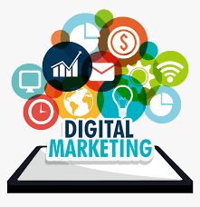



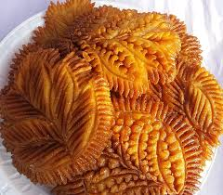
IMC Champaigns of Pitha Angon: Here we outline the Total IMC strategies of Pitha Angon.
Advertising
Sales Promotion
Public Relation
Digital Marketing
Direct or Personal Selling

Slide 11
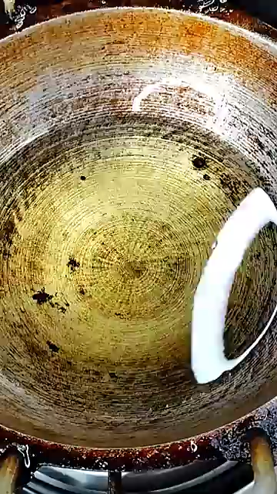

Slide 12

Advertising Strategies Adopted by “Pitha Angon”
Advertising is any paid form of non-personal communication about any organisation, product, service or idea by an identified sponsor.
In the advertising strategy we leverage both traditional and digital media channels to reach a broad audience.
Traditional Media:
Print Advertising
Television
Digital Media:
Social Media Advertising
Google Ads or Digital Ads
Outdoor Advertising
Advertising Strategies including:
1
2

Slide 13


Sales Promotion
Sales Promotion Strategies of “Pitha Angon”:
In-Store Promotions
Limited-Time Offers
Loyalty Programs
Festive Discounts
Bundling
Sampling
A sales promotion is a marketing strategy where a business will use short-term campaigns to spark interest and create demand for a product, service or other offers. Pitha Angon also try to involve in sales promotional strategies.

Slide 14
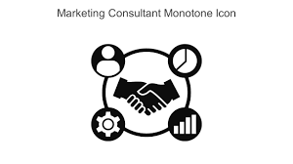
Public Relation
Public Relation Strategies of “Pitha Angon”:
1.Identify and segment the target audience according to:
Demographic segment
Psychographic segment
Media consumption habits
2. Develop relationship with media
3. Participation on special event
4.Maintain partnership with influencer
Public relations (PR) is the process of maintaining a favorable image and building beneficial relationships between an organization and the public communities, groups, and people it serves.

Slide 15
Digital Marketing Strategy
Digital Marketing Strategies Adopted by “Pitha Angon”:
Digital marketing, also called online marketing, is the promotion of brands to connect with potential customers using the internet and other forms of digital communication.
E-mail marketing
Website
3. Social marketing
4. Content marketing

Slide 16



Direct or Personal Selling Strategies Adopted by Pitha Angon:
Email Newsletter
Direct mail
SMS campaign
Catalogs
Retail Partnerships

Slide 17
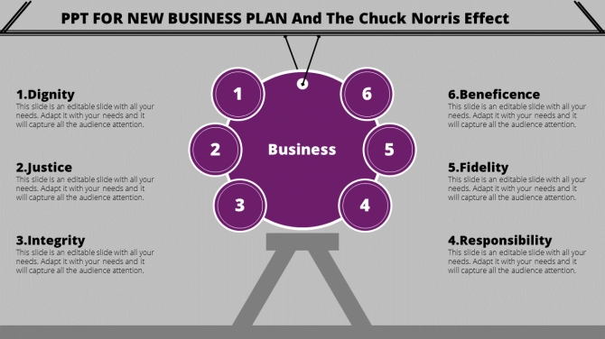
Evaluation and Control Methods of “Pitha Angon”
Sales Metrics:
Monitor sales data to evaluate the effectiveness of promotional strategies.
Website Traffic:
Analyze website traffic to understand the effectiveness of digital marketing efforts.
Recommendations
Brand Awareness Surveys: Conduct surveys to assess changes in brand awareness and customer perceptions.
Sales Data:
Analyze sales before, during, and after campaigns to assess the impact of the IMC strategy.
Social Media Analytics:
Use analytics tools to track engagement, reach, and sentiment on social media platforms.
Customer Feedback:
Gather feedback through surveys, reviews, and focus groups to understand customer satisfaction.

Slide 18


Control Measures:
Regular Monitoring: Continuously monitor the performance of different IMC tools and channels to ensure they are meeting objectives.
Budget Control: Ensure that the campaign stays within the allocated budget and make adjustments if necessary.
Adaptation: Be ready to adapt strategies based on real-time data, such as shifting focus to channels that show higher engagement.
Post-Campaign Analysis: After the campaign, conduct a thorough analysis to identify what worked and what didn’t. This will help in refining future IMC strategies.

Slide 19


